Slide 1

quantumNote
Gage Sharp | Kyle Brownell | Martin Ramirez | Kong Her | Sukhpreet Singh

Slide 2
What is quantumNote?
Note taking application geared for students
Made for android tablets
Full of features to take quick and easy notes

Slide 3
Design
Coded in java and xml
Observer model
MVC Architecture
model - java
view - xml
controller - android activities

Slide 4
Verification
Stress testing with Exerciser Monkey
JUnit testing on applicable classes

Slide 5
Maintainability
Java files organized based on function and activity
Android project file structure
Custom inkView and audio recorder

Slide 6
Features
Typing
Drawing Tools
Record Audio
ColorPicker
RayMenu
Dynamic Highlighting

Slide 7
Issues in Development
Android Studio
Experience
Time

Slide 8
Future Features
In Development
Lasso Select
Translate, rotate, scale
Camera
Planned
Folders/Notebooks
Import/Export
Science Tools

Slide 9
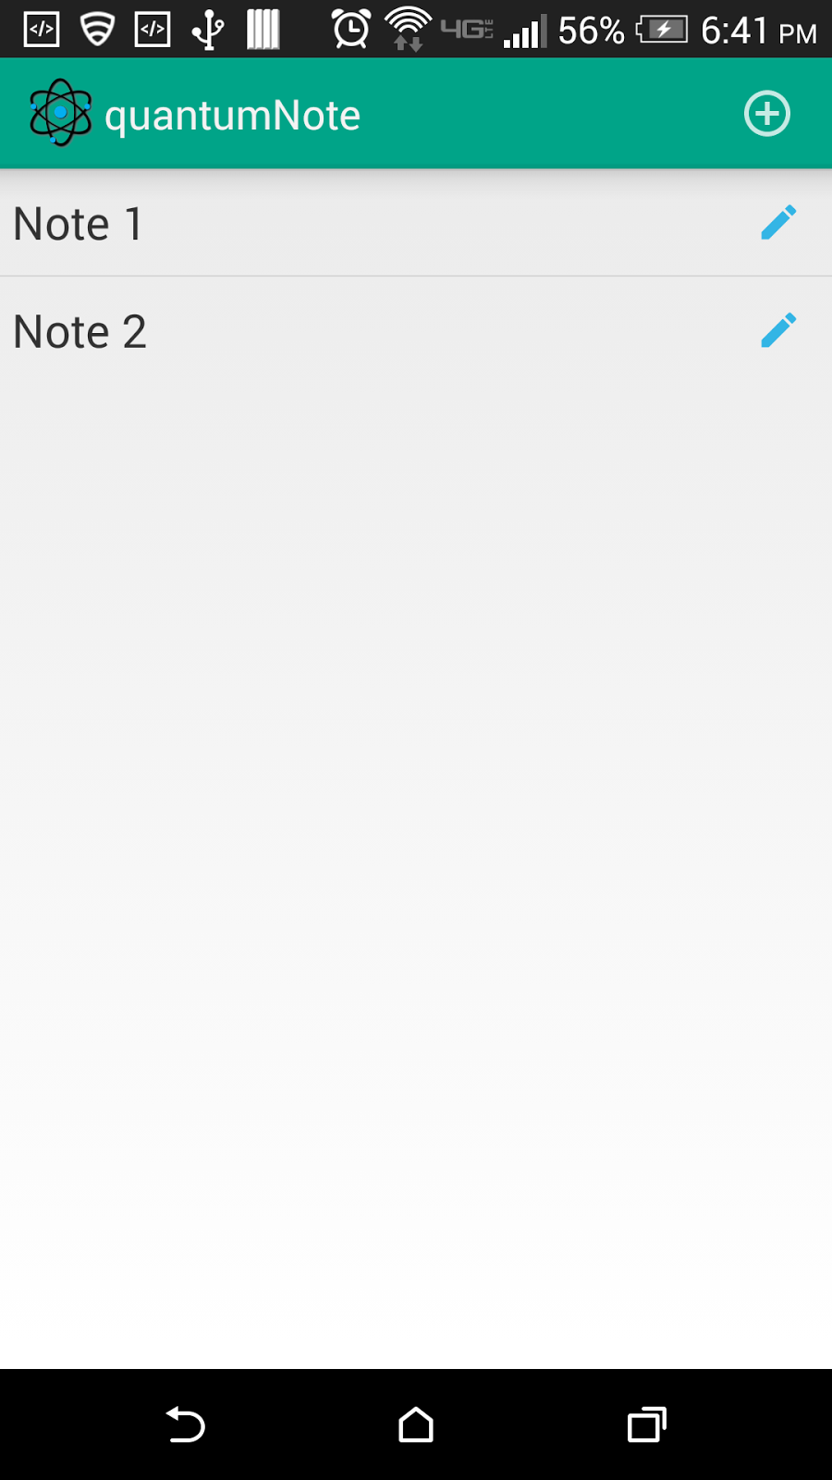
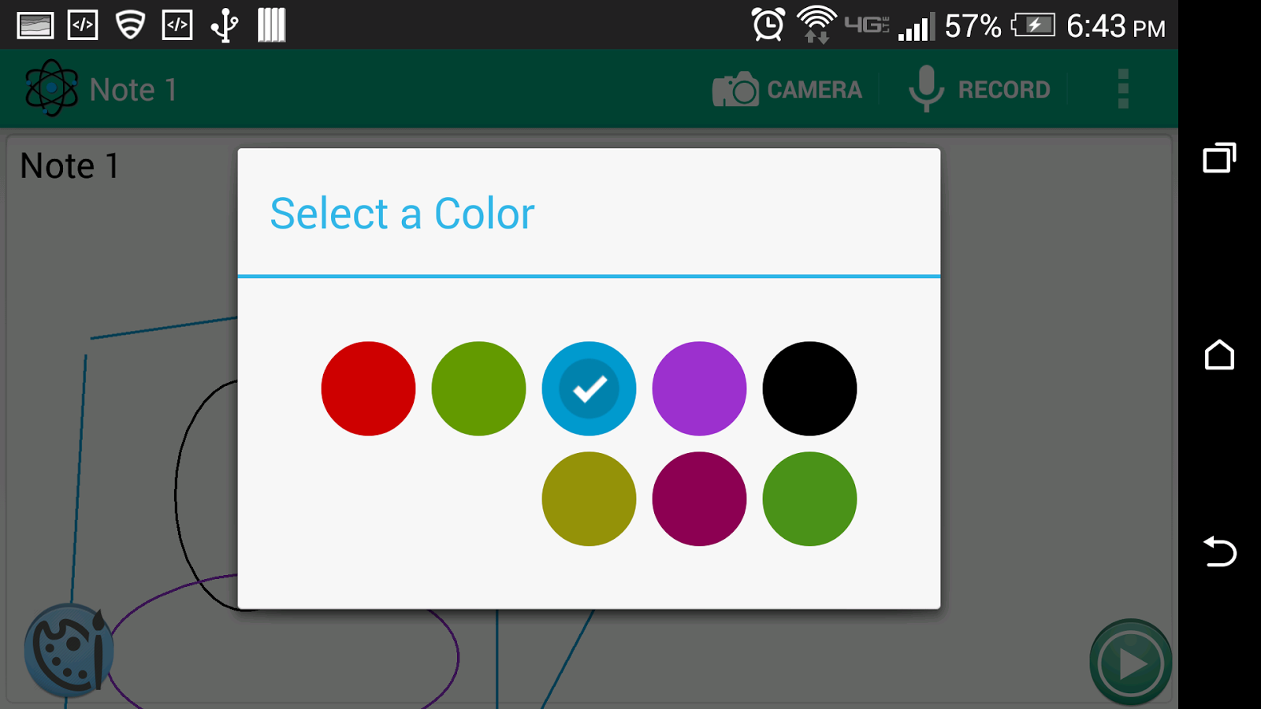
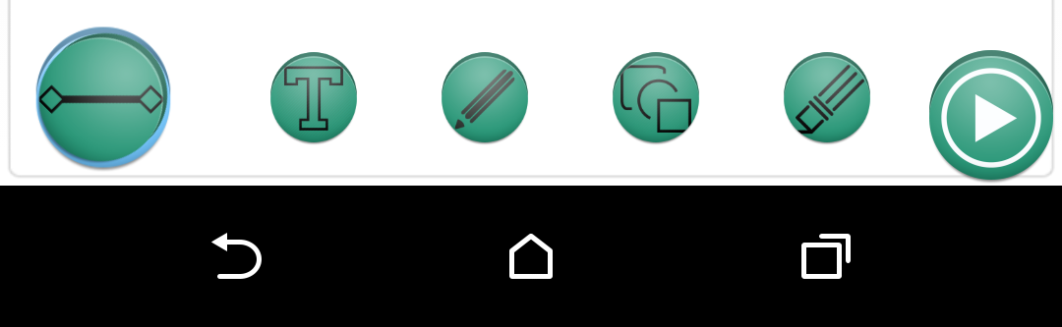

Slide 10
